Slide 1
Quantum Error Correction Codes
Rajesh Sathya Kumar

Slide 2
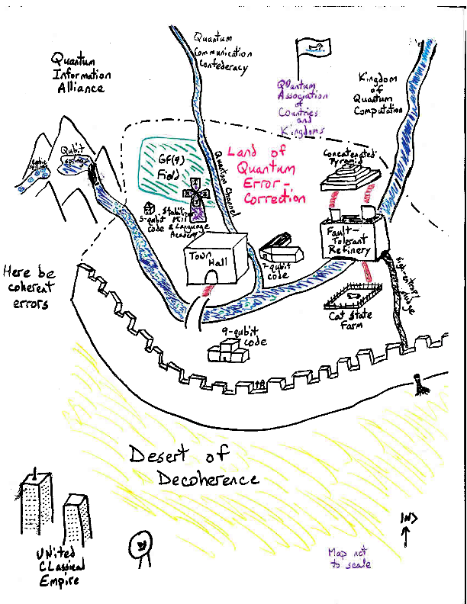
Classical and Quantum Worlds

Slide 3
Quantum Errors
A general quantum error is a superoperator:
ρ → Σ A_{k} ρ A_{k}†
Examples of single-qubit errors:
Bit Flip X: X⎟0⟩ = ⎟1⟩, X⎟1⟩ = ⎟0⟩
Phase Flip Z: Z⎟0⟩ = ⎟0⟩, Z⎟1⟩ = -⎟1⟩
Complete dephasing: ρ → (ρ + ZρZ†)/2 (decoherence)
Rotation: R_{θ}⎟0⟩ = ⎟0⟩, R_{θ}⎟1⟩ = e^{iθ}⎟1⟩

Slide 4
Barriers to Quantum Error Correction
Measurement of error destroys superpositions.
No-cloning theorem prevents repetition.
Must correct multiple types of errors (e.g., bit flip and phase errors).
How can we correct continuous errors and decoherence?

Slide 5
Measure the Error, Not the Data
Use this circuit:
Encoded state
Ancilla qubits
⎟0⟩
Error syndrome
⎟0⟩
1st bit of error syndrome says whether the first two bits of the state are the same or different.
2nd bit of error syndrome says whether the second two bits of the state are the same or different.

Slide 6
Correcting Just Phase Errors
Hadamard transform H exchanges bit flip and phase errors:
H (α⎟0⟩ + β⎟1⟩) = α⎟+⟩ + β⎟-⟩
X⎟+⟩ = ⎟+⟩, X⎟-⟩ = -⎟-⟩ (acts like phase flip)
Z⎟+⟩ = ⎟-⟩, Z⎟-⟩ = ⎟+⟩ (acts like bit flip)
Repetition code corrects a bit flip error
Repetition code in Hadamard basis corrects a phase error.
α⎟+⟩ + β⎟-⟩ → α⎟000⟩ + β⎟000⟩

Slide 7
Nine-Qubit Code
To correct both bit flips and phase flips, use both codes at once:
α⎟0⟩ + β⎟1⟩ →
α(⎟000⟩ + ⎟111⟩)^{⊗3} + β(⎟000⟩ - ⎟111⟩)^{⊗3}
Repetition 000, 111 corrects a bit flip error, repetition of phase +++, --- corrects a phase error
Actually, this code corrects a bit flip and a phase, so it also corrects a Y error:
(global phase irrelevant)
Y = iXZ: Y⎟0⟩ = i⎟1⟩, Y⎟1⟩ = -i⎟0⟩

Slide 8
Correcting Continuous Rotations
How does error correction affect a state with a continuous rotation on it?
R_{θ}^{(k)}⎟ψ⟩ = cos (θ/2)⎟ψ⟩ - i sin (θ/2) Z^{(k)}⎟ψ⟩
cos (θ/2)⎟ψ⟩⎟I⟩ - i sin (θ/2) Z^{(k)}⎟ψ⟩ ⎟Z^{(k)}⟩
Error syndrome
Measuring the error syndrome collapses the state:
Prob. cos² (θ/2): ⎟ψ⟩ (no correction needed)
Prob. sin² (θ/2): Z^{(k)}⎟ψ⟩ (corrected with Z^{(k)})

Slide 9
Correcting All Single-Qubit Errors
Theorem: If a quantum error-correcting code (QECC) corrects errors A and B, it also corrects αA + βB.
Any 2x2 matrix can be written as αI + βX + γY + δZ.
A general single-qubit error ρ → Σ A_{k} ρ A_{k}† acts like a mixture of ⎟ψ⟩ → A_{k}⎟ψ⟩, and A_{k} is a 2x2 matrix.
Any QECC that corrects the single-qubit errors X, Y, and Z (plus I) corrects every single-qubit error.
Correcting all t-qubit X, Y, Z on t qubits (plus I) corrects all t-qubit errors.

Slide 10
Progress this week
Studied Different Error Correction Codes
Continued incorporating other benchmarks such as Average Circuit Depth, width, Average fidelity and CLOPS to the python library
Next Week:
Continue Studying more on error correction codes.

Slide 11
References
1. A. M. Steane, “A tutorial on quantum error correction,” in
Proceedings of the International School of Physics “Enrico Fermi,”
2006, vol. 162, pp. 1–32.
2. C. H. Bennett, “Quantum Information: Qubits and Quantum Error
Correction,” in International Journal of Theoretical Physics, Feb.
2003, vol. 42, no. 2, pp. 153–176.
3. R. Vathsan, Quantum Error Correction. Cambridge university
press, 2020.

